Slide 1
NCB Analytics Project
Employee Engagement, Customer Satisfaction & Branch Performance
Presented by: Jitender Singh ,
Srija Sama , Sanjani Ksheerasagar

Slide 2

Agenda
Introduction
Data Overview
Methods
Key Findings
Conclusion

Slide 3
Introduction
Purpose of Study:
Explore connection between employee engagement → customer service → performance
Identify drivers of satisfaction and loyalty
Support NCB’s evidence-based decision-making

Slide 4
Data Overview
Datasets Used:
• Employee survey (2,200 responses)
• Customer satisfaction (14,000 responses)
• Branch performance (128 branches)
• 21 variables after merging

Slide 5
Methods
Analytical Techniques
• Descriptive analytics
• Regression
• Correlation analysis
• K-means clustering
• Shiny dashboards for visualization

Slide 6
Key Finding 1 – Employee → Customer Service
• Engagement, communication & training positively relate to service quality
• Teamwork & involvement weaker effects

Slide 7
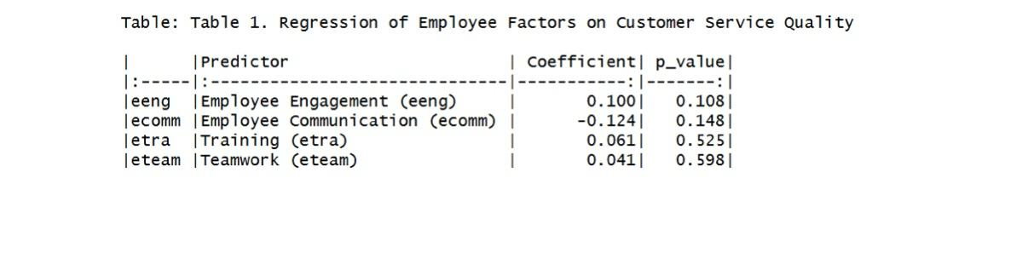
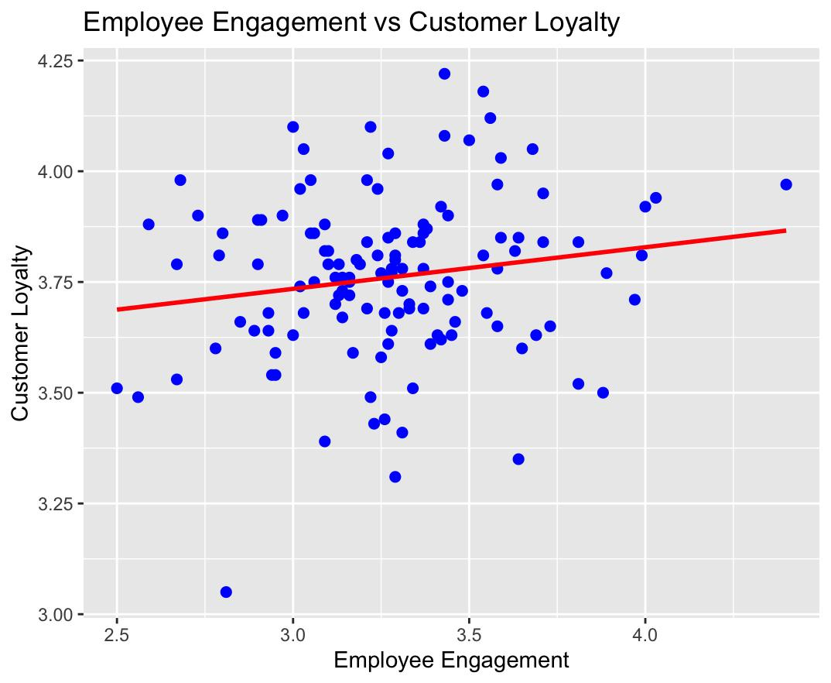
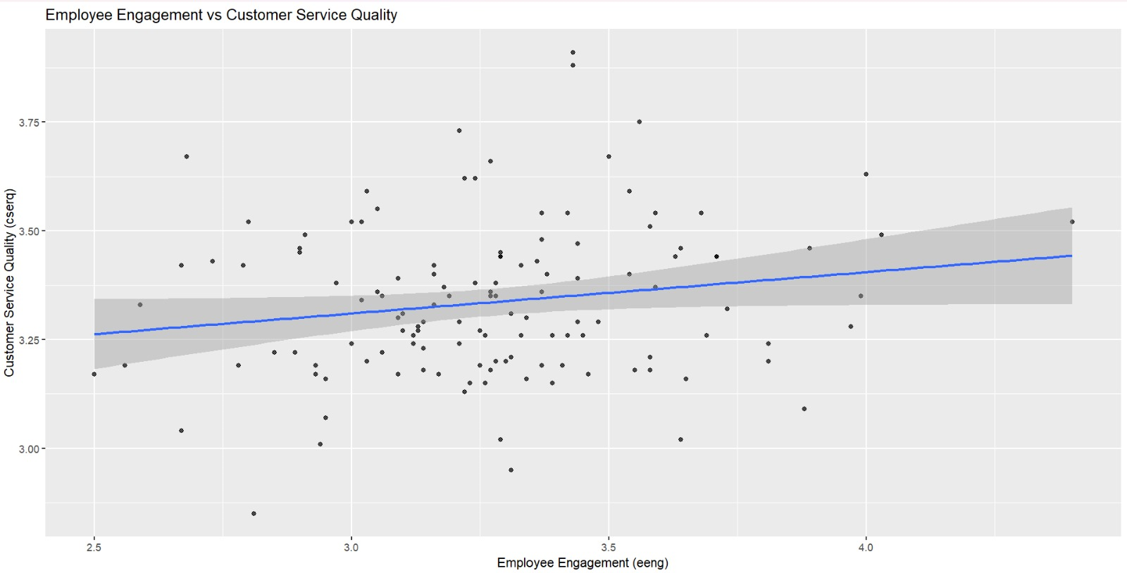
Employee Engagement vs Service Quality

Slide 8
Key Finding 2 – Customer Service → Loyalty
• Strongest relationship in the dataset
• Service quality predicts loyalty (R² ≈ 0.81)

Slide 9
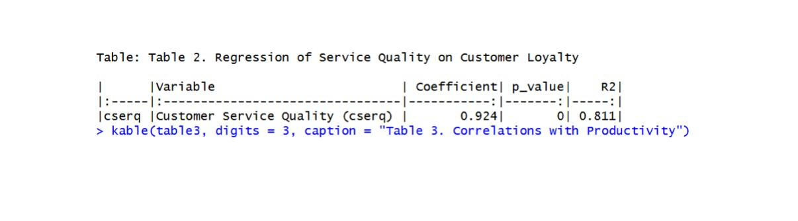
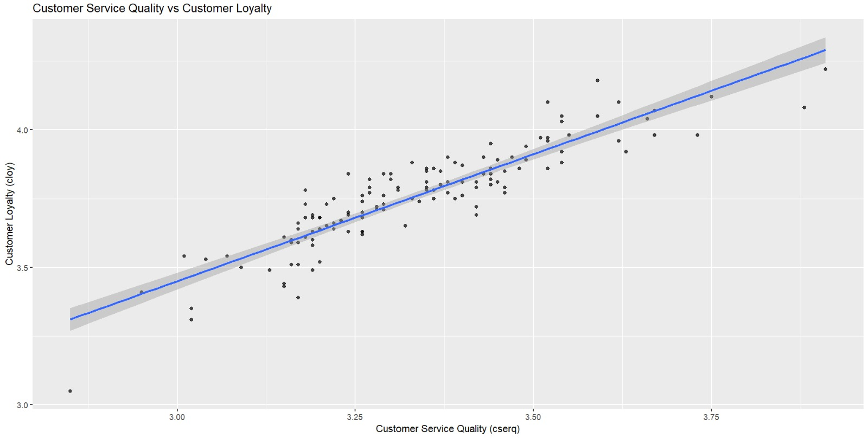
Customer Service Quality vs Loyalty

Slide 10
Key Finding 3 – Drivers of Productivity
• Loyalty has weak effect on productivity
• Teller transactions stronger operational driver

Slide 11
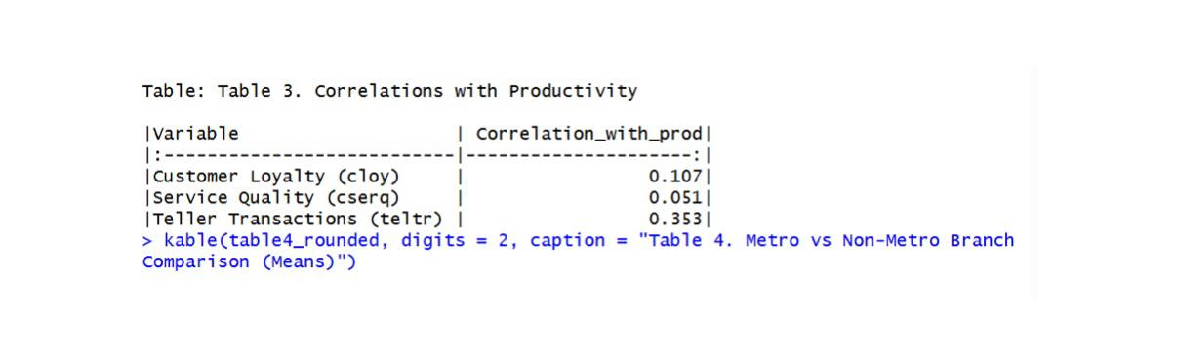
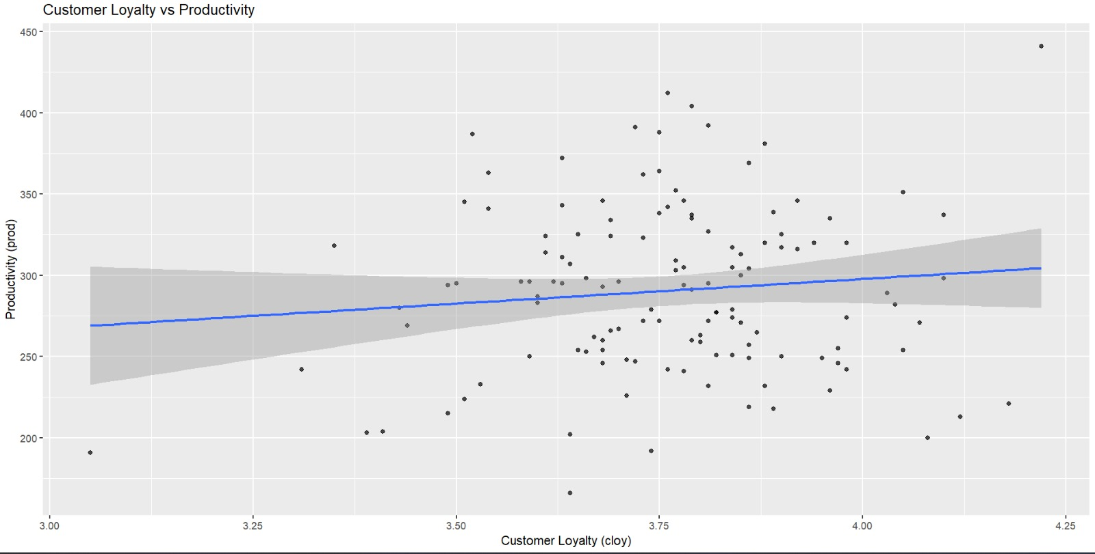
Customer Loyalty vs Productivity

Slide 12
Metro vs Non‑Metro
• Metro branches significantly more productive
• Customer experience scores similar

Slide 13
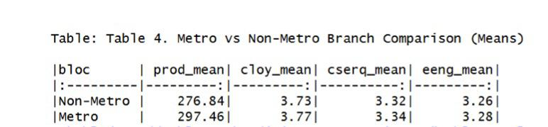
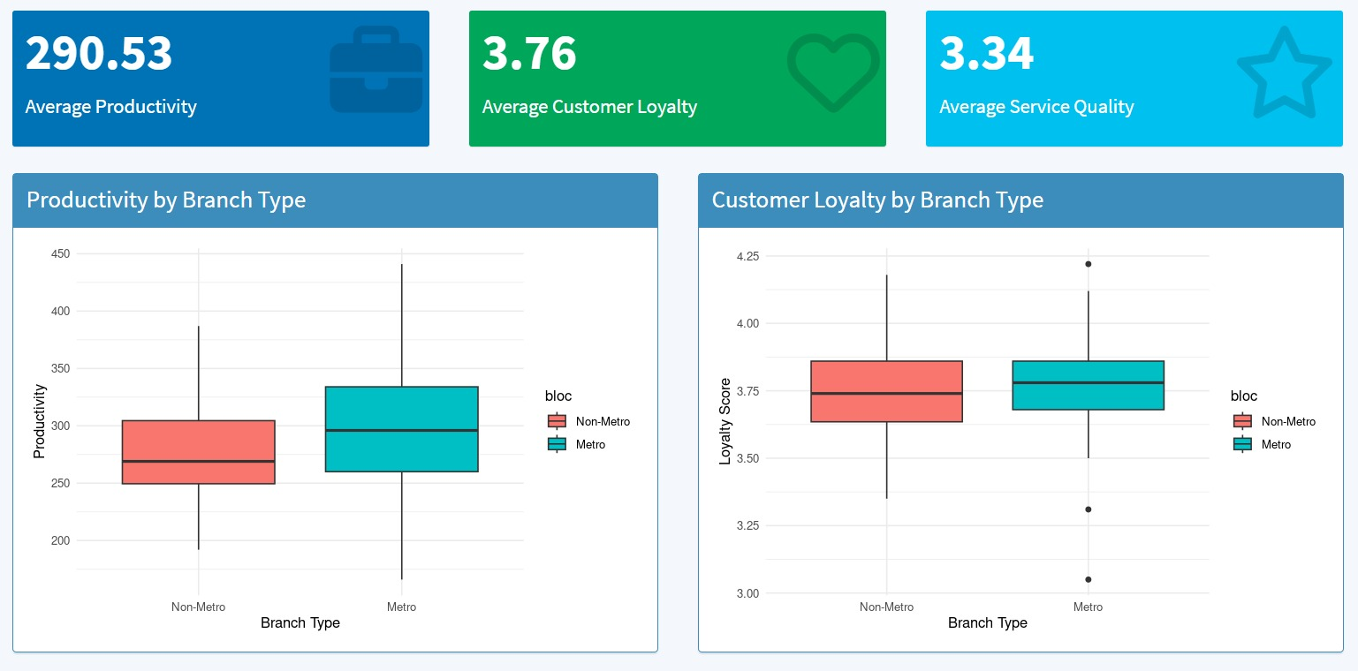
Metro vs Non‑Metro Performance

Slide 14
Correlation Heatmap
Coherent internal climate
Service excellence drives loyalty
Productivity is driven by operations

Slide 15
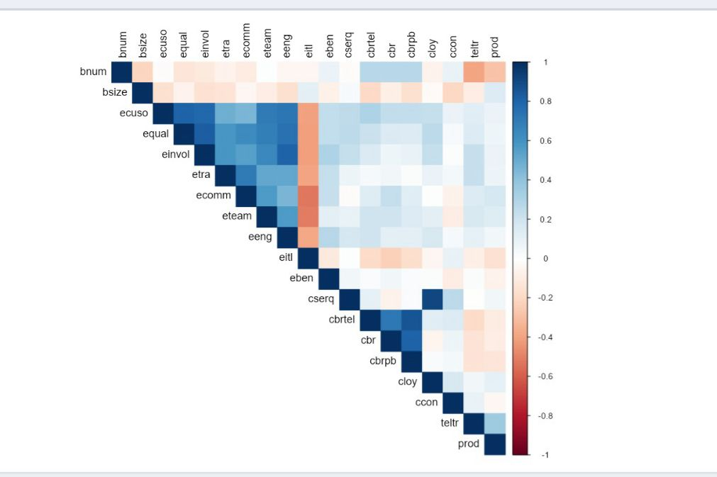
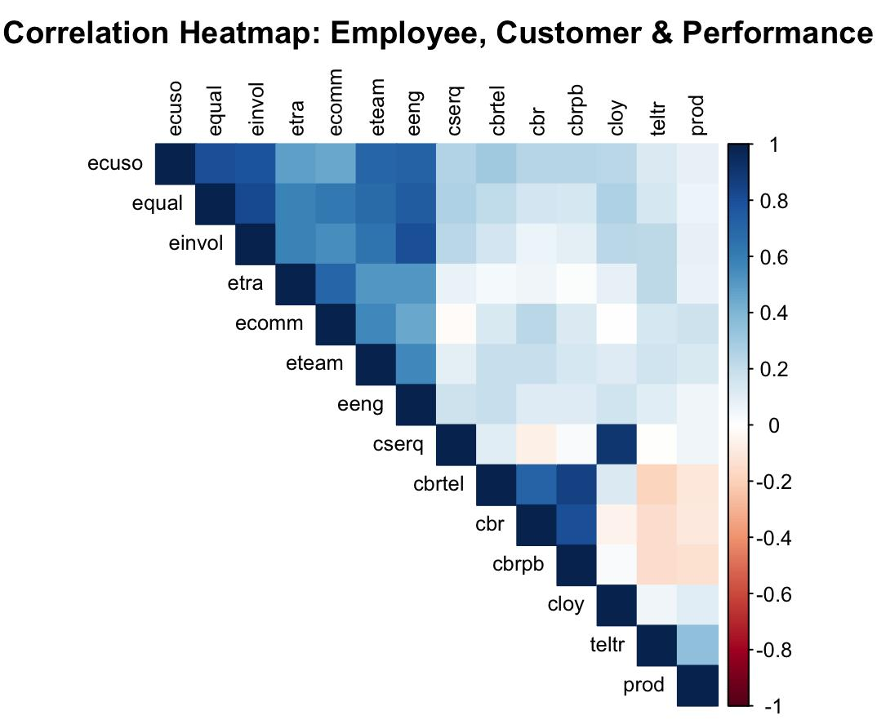
Employee → Customer → Performance Chain

Slide 16
Cluster Analysis
• Cluster 1: High performers
• Cluster 2: Moderate
• Cluster 3: Low performing (needs intervention)

Slide 17
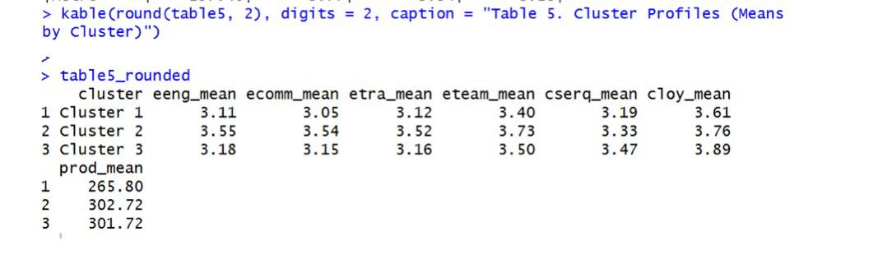
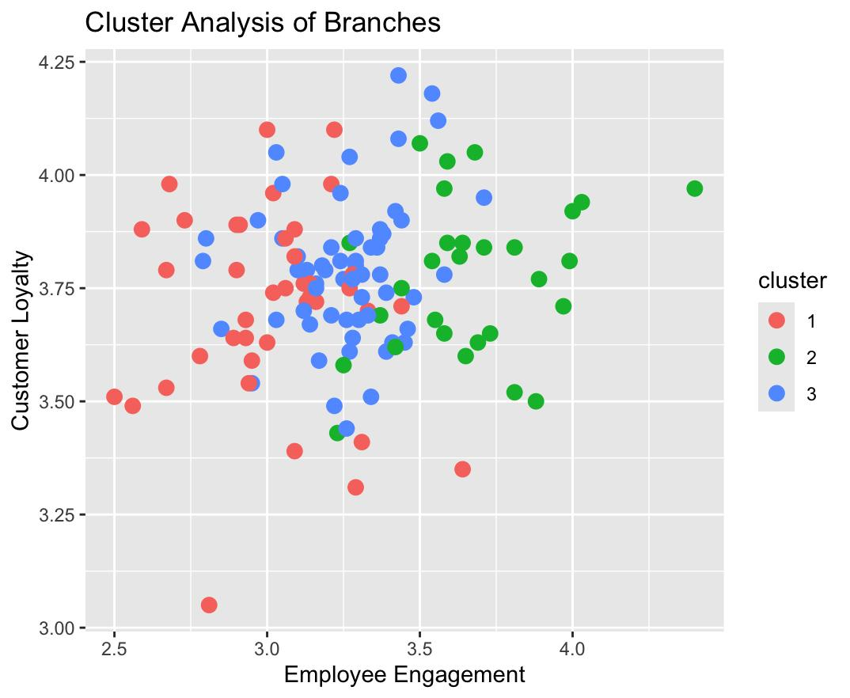
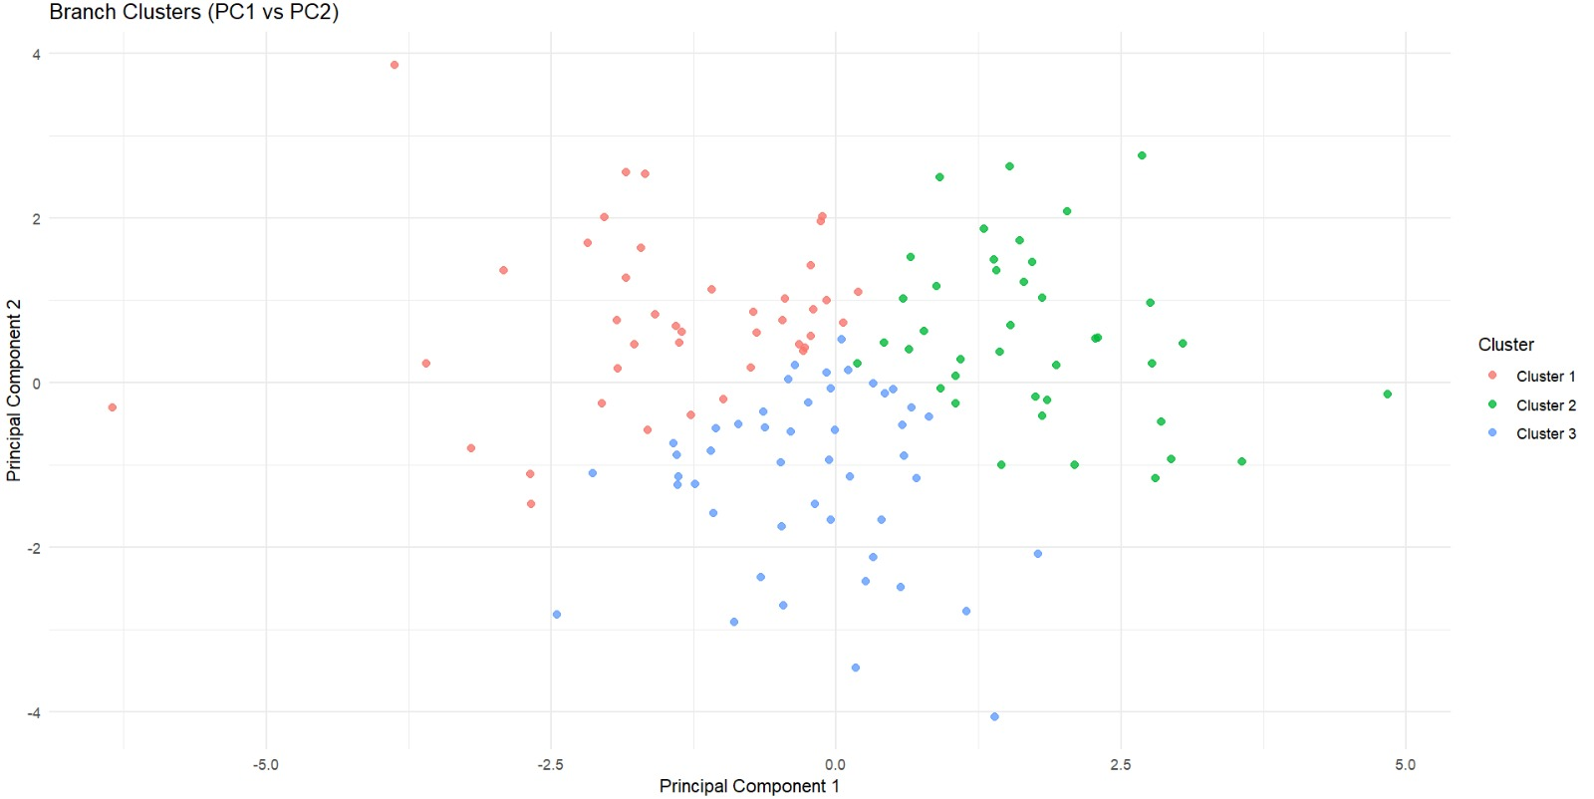
Branch Clusters (PCA)

Slide 18
Conclusion
• Employee conditions shape customer outcomes
• Service quality strongly drives loyalty
• Productivity driven more by volume
• Supports NCB’s strategic planning

